Slide 1
Hackoverflow 4.0
SEGREGATION OF SILKWORM COCOONS

Slide 2
Team Name: 2 legit 2 quit
Team members details:
Rohith Kanna.L.M Msc.Software Systems
Ruthsan.R MSc.Software Systems
Rohith.S MSc.Software Systems

Slide 3
Problem statement: Segregation of silk cocoons in sericulture has been a tedious job that includes a huge manpower that results in more time consumption and more cost of expenditure.

Slide 4
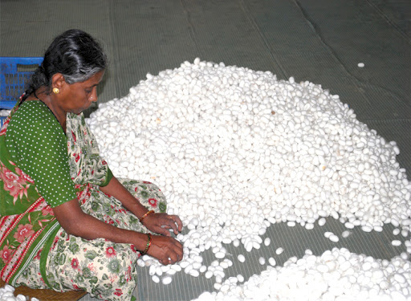
Problem Inspired From……. Based on the difficulties experienced by a person working in this field

Slide 5
Our solution:
Our Proposed Model is Automatic It consists of 1.Conveyer Belt 2.Two cameras 3.PIR sensor 4.Raspberry Pi 3 A+ 5.CNN(Convolutional Neural Network) using Mobilenet Architecture

Slide 6
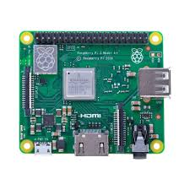
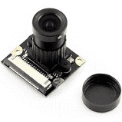
ML MODEL
Raspberry Pi 3 A+ chip
Cameras

Slide 7
Existing solution vs Our solution:
Existing solution is done by Man power | Automated system which involves a ML model
It is segregated by handpicking. | It is segregated by image processing.
High manpower. | Minimum Manpower
High Time consumption | Less Time consumption
High cost of Expenditure | Less cost of expenditure

Slide 8
Novelty of our project: There are no real time applications of our project model of segregating silkworm cocoons in India. This model will consume no manpower, less time consumption and less cost of expenditure. If implemented in realtime it could drastically change the field of sericulture that will both benefit the farmers as well as end customers who will be able to buy silk products at a cheaper rate.

Slide 9
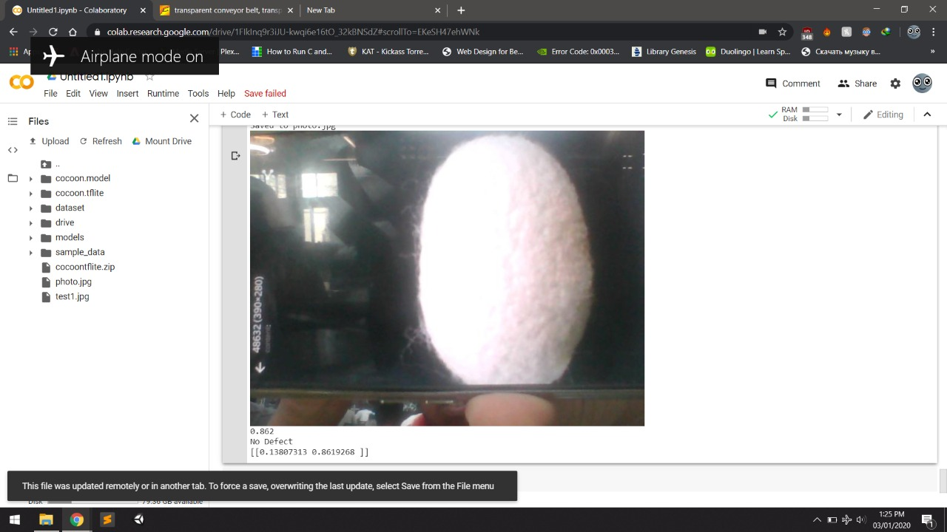
Application of our Proposed Solution

Slide 10
Components utilized: 1.Conveyer Belt 2.Two cameras(Pi camera ) 3.PIR sensor 4.Raspberry Pi 3 A+ 5.CNN(Convolutional Neural Network) using Mobilenet Architecture

Slide 11
Technology incorporated: Machine Learning: We have made a CNN(Convolutional Neural Network) which will distinguish between the qualities of cocoons by image processing. Raspberry Pi 3 A+: Signal generation for controlling motors in conveyor belt Processing our Project’s Neural Network To fetch image from camera and send it to CNN has a connection with safety equipment

Slide 12
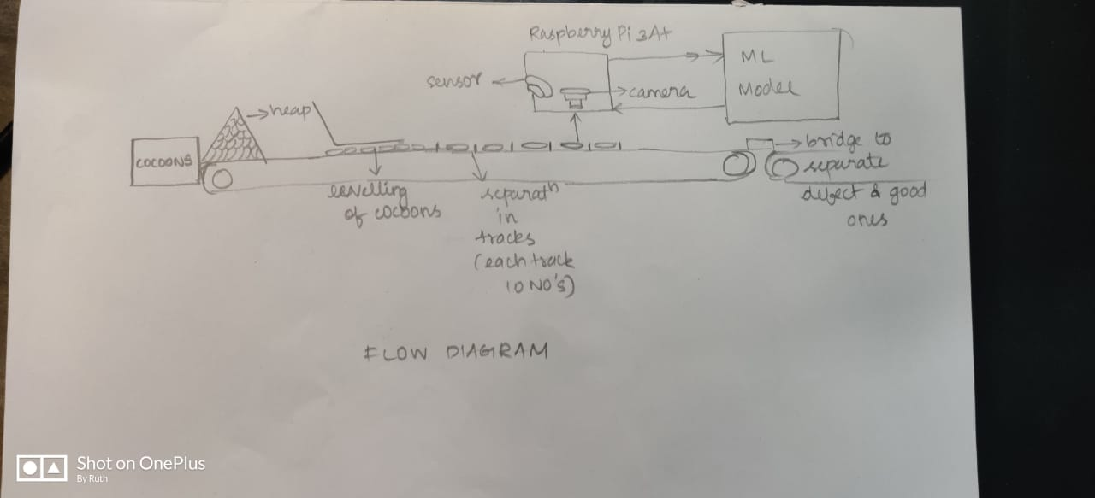
Working:
(explain working of prototype in a flow diagram)

Slide 13
Prototype:

Slide 14
THANK YOU!

